Slide 1

Analysis of House Prices King Louis Estate / USA
PRESENTATION 17.09.2020
Britta Röver
Notes:
1
1

Slide 2
Agenda
Approach to the Data / Business Understanding
Data Cleaning
Data Analysis and Exploration
Feature Engineering
Preditive Modelling
Data Visualization
Findings trough the Data

Slide 3
DATA
column |  | type | values
id | Unique identifier | int
date | Date house was sold | object
price | price | float |  | outliner
bedrooms | Number of bedrooms | int | discret/1-11 | outliner
bathrooms | Number of bathrooms | float | discret/0-7
Sqft_living | Square footage/house | int
Sqft_lot | Square footage/lot | int
floors | Number of floors | float | discret/1-4
waterfront | View to the waterfront | float | 1/0 | Missing values
view | Indicator for a special view | float | ranking 0-4 | Missing values
condition | Indicator for condition | int | discret/1-5
grade | Indicator for grade / base on a local grading system | int | discret/1-13

Slide 4
DATA
column |  | type | values
Sqft_above | Square footage without basement/house | int |  | Can be skipped
Sqft_basement | Square footage basement | object |  | Missing values Wrong data New computation of the value additional feature basement y/n
Yr_built | Built year | float | discret | additional features yr_age and yr_built_cat
Yr_renovated | View to the waterfront | float | discret, 1/0 | additional feature renovation
zipcode | Indicator for a special view | float | discret, ranking 0-4
Lat long | Coordinates (latitude and longitude) | Both float
Sqft_living Sqft_lot | Square footage /living and lot of the nearest 15 neighbours | int

Slide 5
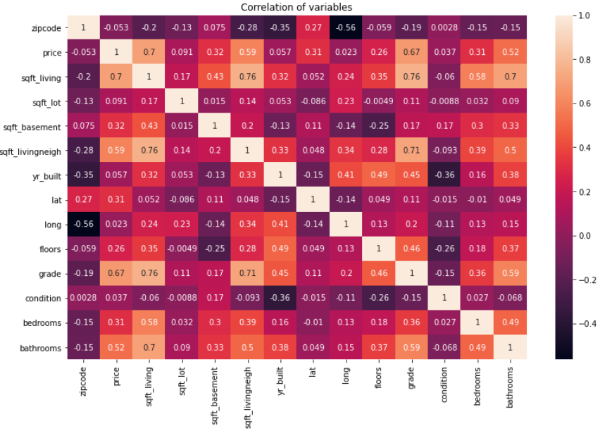
Get a big picture!
Matrix of correlations
There seems to be a couple of stronger correlationen concerning the price
Living space
Grade
Distance to neighbour
bedrooms
But there are also dependencies between the features, see feature grade

Slide 6
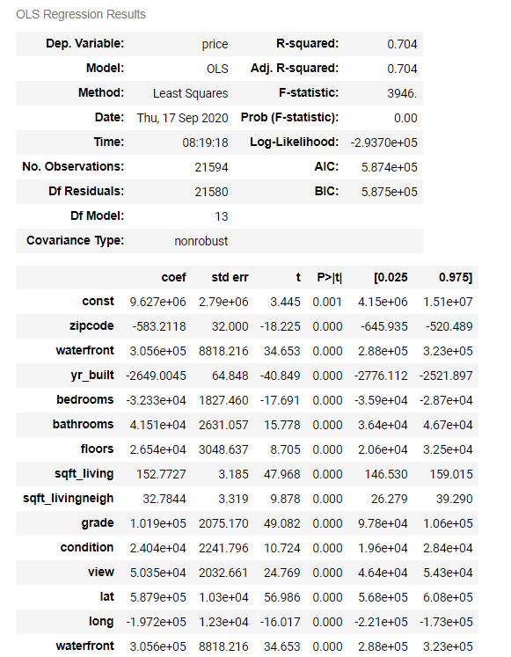
1. Shot:
Multilinear Regression
features used
Living and lot space
grade
distance to neighbour
Bed- and bathrooms ..
result: R2 of 0,704

Slide 7
STORY:
A new home for me, my husband and my 3 daughter
WHAT IS IMPORTANT FOR US?
The size that means sqft_living and sqft_lot, strong condition for sqft_living >=130 qm2
The number of bath- and bedrooms:
bedrooms at least 4
bathrooms at least 2
The house should have a big basement
It should have a good condition/grade
Nice Place! Waterfront!
Old house?

Slide 8
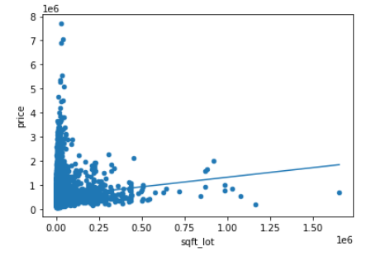
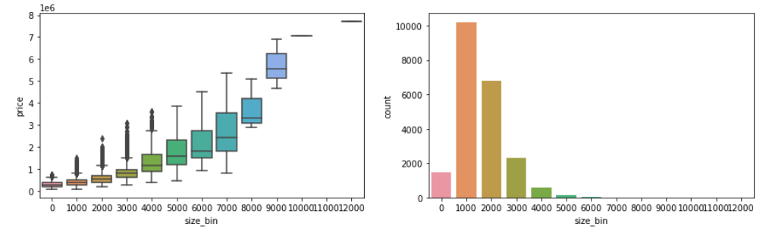
SiZE:
Finding: SIZE LOT RULES SIZE LIVING!
There is a strong relationship between the size of the house and the price
But: 77 % of all houses fulfill the size criteria

Slide 9
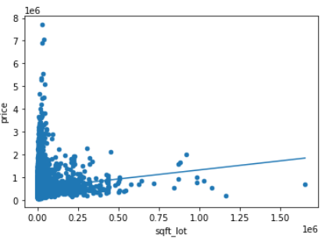
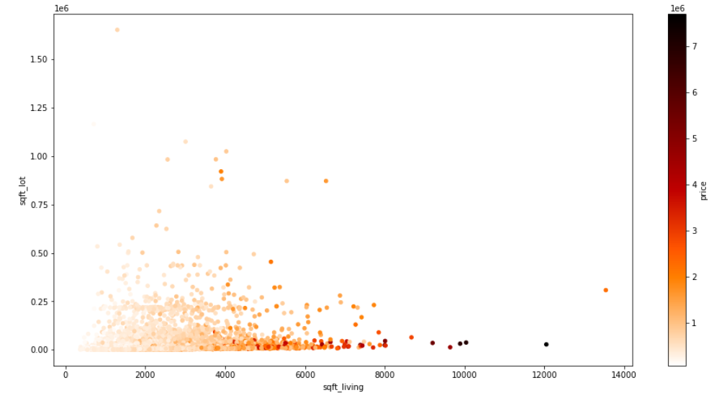
SiZE (2):
Finding: SIZE LOT RULES SIZE LIVING!
There is no strong relationship between the size of the lot and the price on the one hand and between lot and house size on the other hand
BIG LOT and MINIMUM HOUSE SIZE

Slide 10
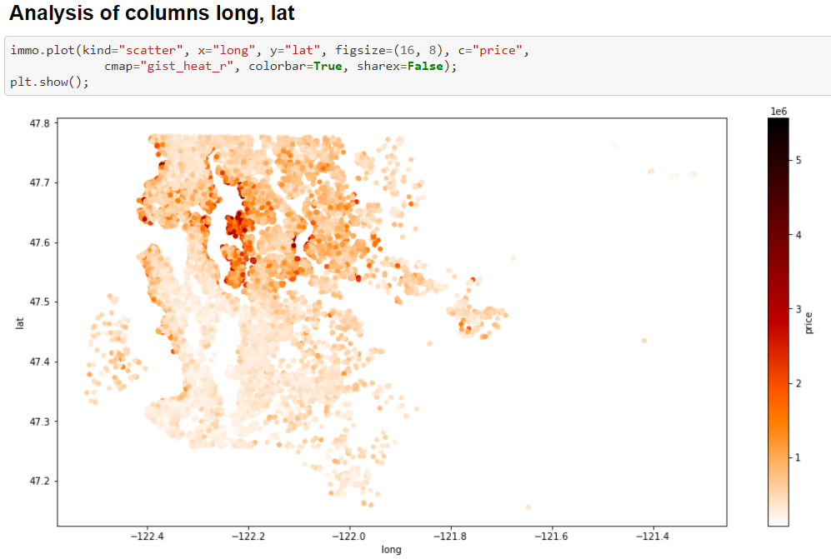
NICE PLACE:
Finding : Waterfront is the most expensive option
But the prices varies
Maybe the west part of the lake is also nice?
Have a look!

Slide 11
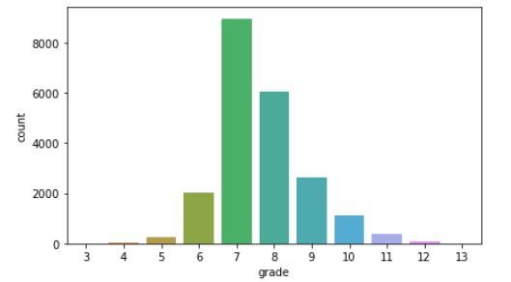
NICE PLACE:
Finding 2: the grade is not so important for us!
Not fully clear by definition
Strong relationship between grade and bathrooms and bedroomnumbers
This both is important to us!
Grade should be at least average (grade==7)
But at the waterfront only 3 objects have a grade <7

Slide 12
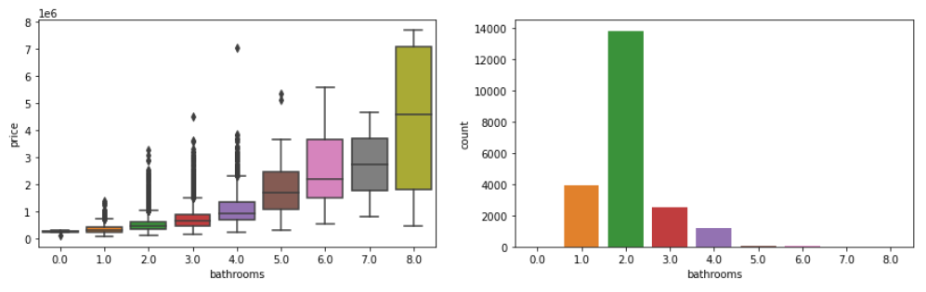
BATHROOMS:
Finding 3: 2 Bathrooms are enough!
Bathrooms become more expensive by the size of 2!
2 Bathrooms are enough! This also seems to be the standard size

Slide 13
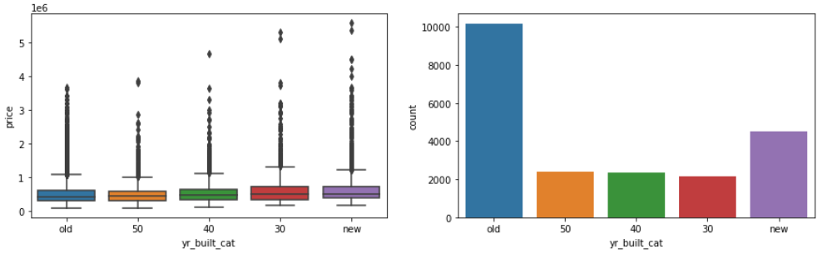
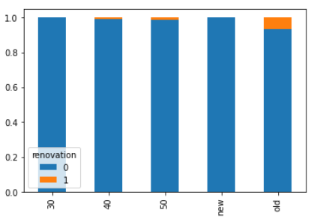
OLD HOUSE:
Finding 4: only a small part has been renovated!
Have a look!

Slide 14
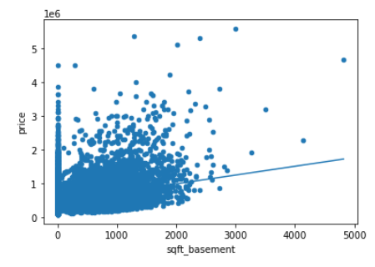
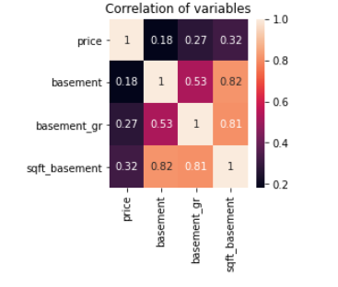
BASEMENT:
Finding 4: size is not so expensive!
The fact basement yes or no has also a important effect to the price!
The Size is not so expensive

Slide 15
STORY:
A new home for me, my husband and my 3 daughter
WHAT IS IMPORTANT FOR US?
The size that means sqft_living and sqft_lot, strong condition for sqft_living >=130 qm2 YES
The number of bath- and bedrooms:
bedrooms at least 4
bathrooms at least 2
The house should have a big basement
It should have a good condition/grade <=7
Nice Place! Waterfront may be!
Old house? may be!

Slide 16
THANKS!

